Slide 1
Plan for Writing a Report on Chromatix
dominik.kuehn@lighttransinternational.onmicrosoft.com
Ziyi Xiong

Slide 2
Contents
1. Writing Platform
2. Contents of the Report
Introduction to Chromatix
Analysis of the source codes
Performance Test
Conclusion
References

Slide 3
Writing Platform
JupyterLab: an interactive development environment
Jupyter Notebook
Executable Codes
Texts
Equations
Plots

Slide 4
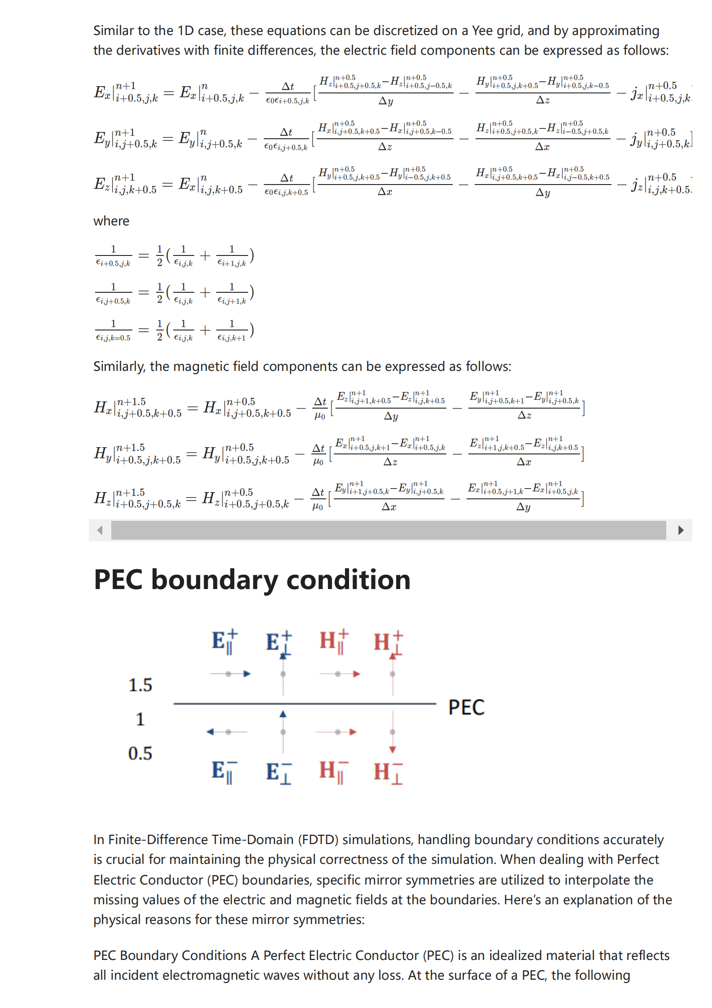
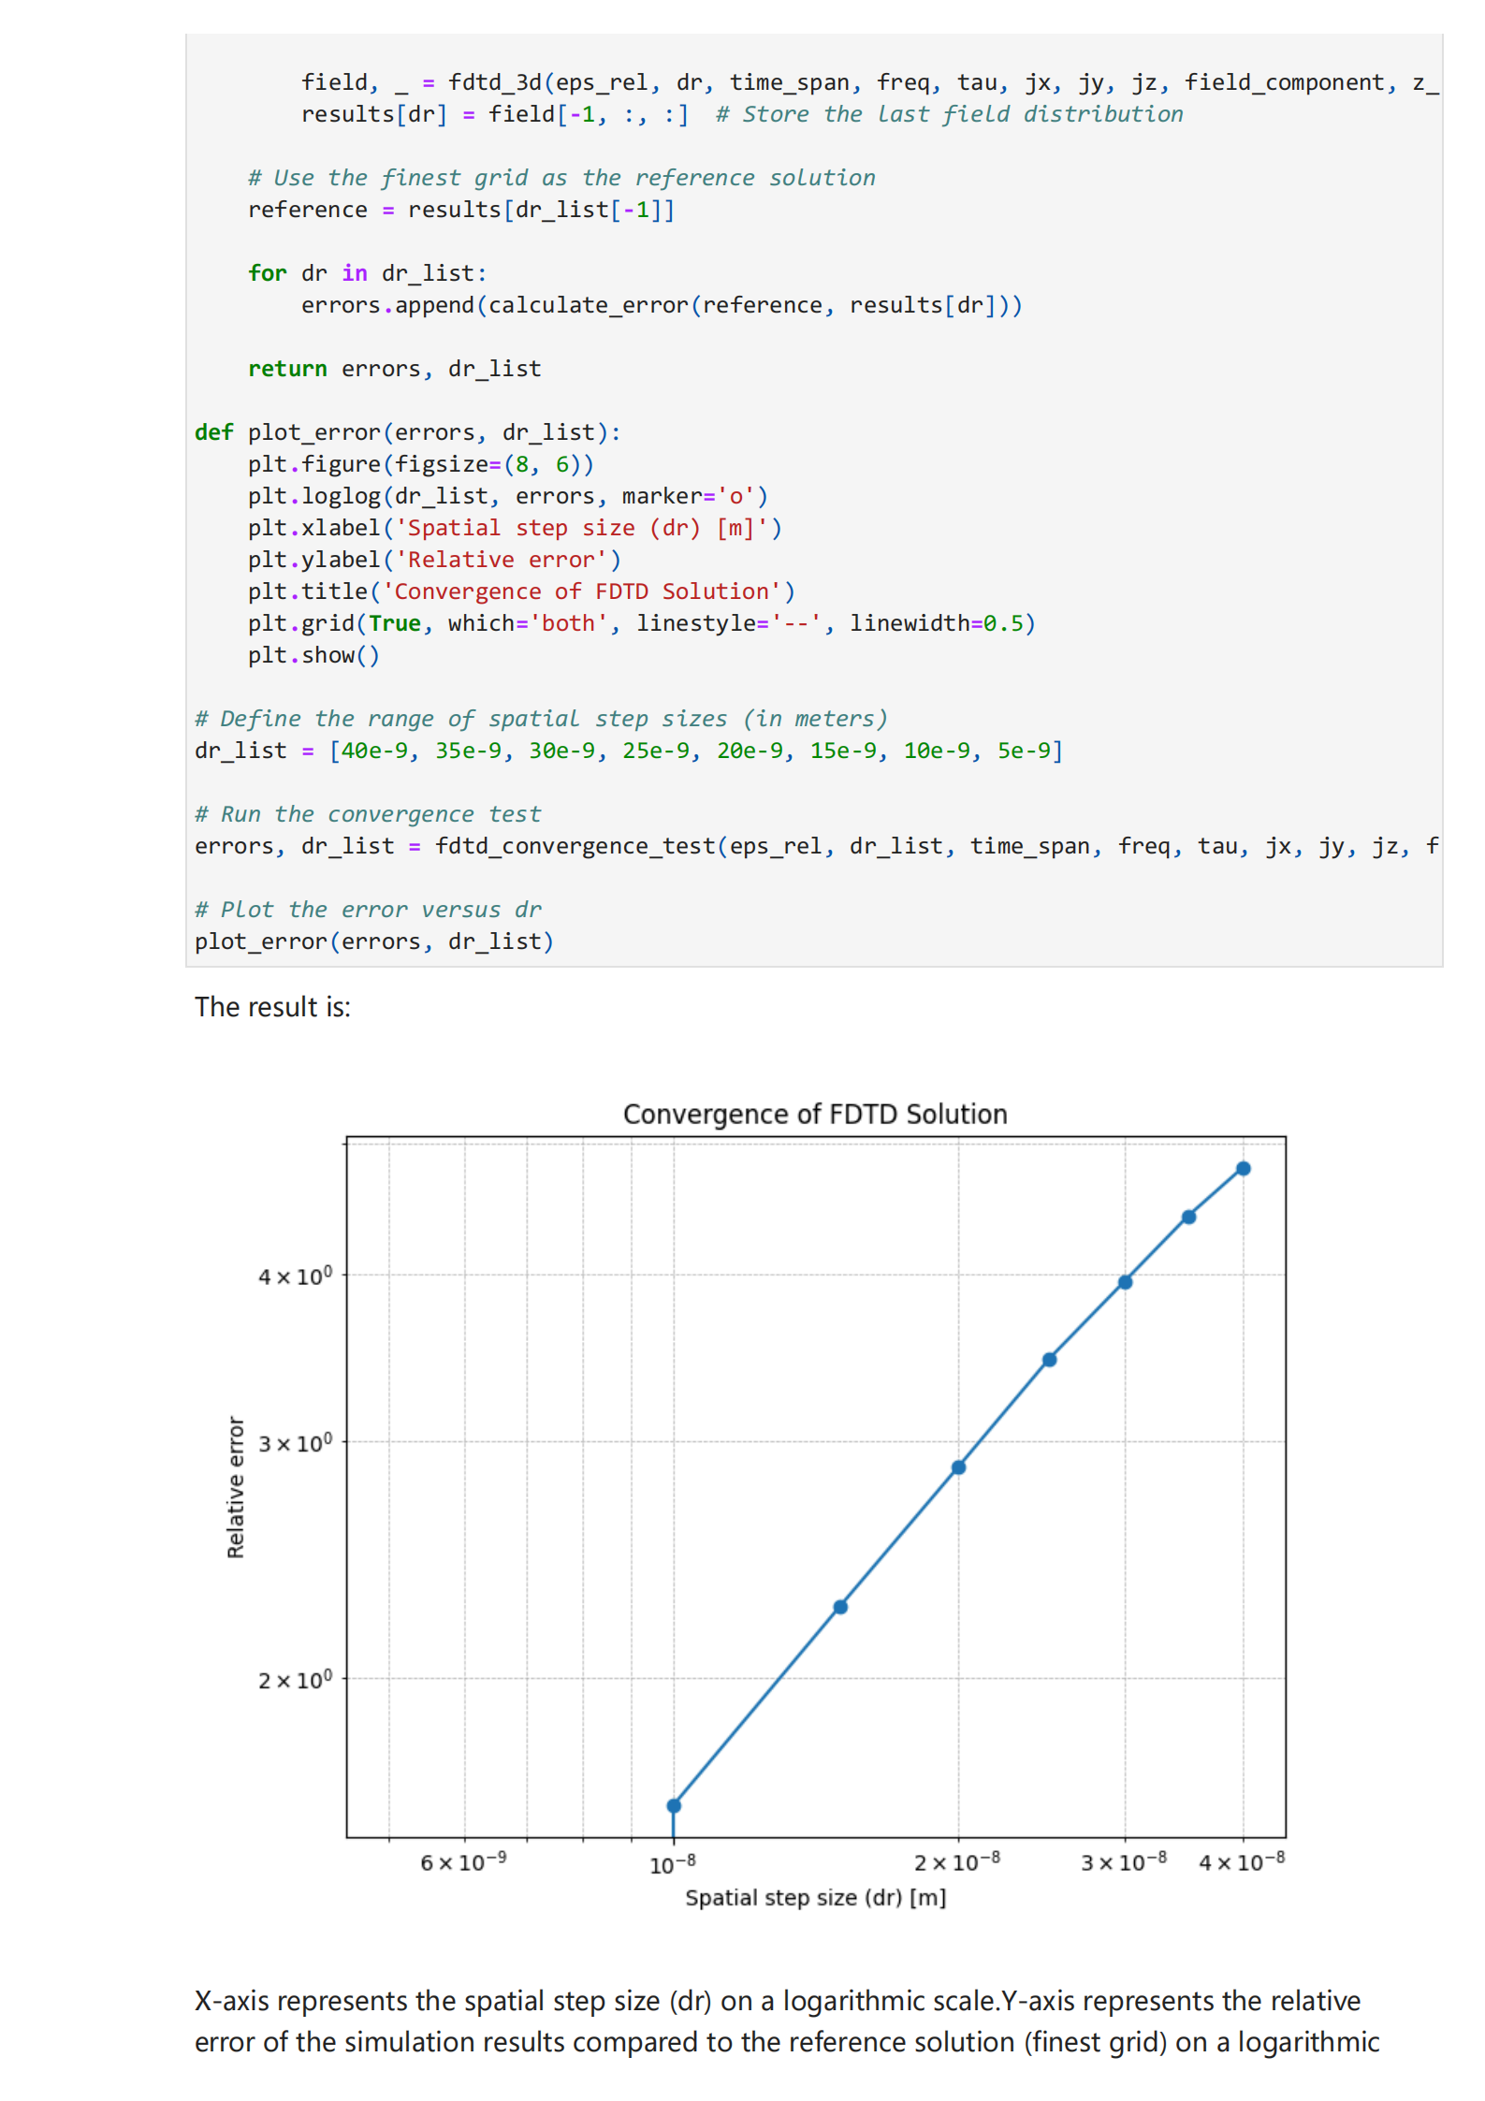
Writing Platform

Slide 5
Contents of the Report
Purpose of the Report
Background of the Library
Introduction:
Overview of the Library
Installation

Slide 6
Contents of the Report
Structure of the Source Codes
Physical and Mathematical Background
Analysis of the source codes:
Details of the Codes
Potential Improvements or Customization
The Given Examples

Slide 7
Contents of the Report
Speed and Accuracy
Recource Comsumption
Performence Test:
Limitations
Stability
Convergence

Slide 8
Contents of the Report
Summary of Findings
Conclusion:
Recommendations
References:
Citation of Equations, Principles and Codes

Slide 9
Focal Plane
Lens
Field after Lens
z
f

